Slide 1
Lesson objective
Title: Circumference and Area
Aim:
Practicing calculating area and circumference of a circle
Plan:
Review key features
Calculating circumference and area

Slide 2
Key features
Circumference
Circle edge/perimeter
Radius
From center of the circle to outside edge
Diameter
Straight line through the center, edge to edge
Diameter is twice the length of its radius

Slide 3
Key features
Circumference
Circle edge/perimeter
Radius
From center of the circle to outside edge
Diameter
Straight line through the center, edge to edge
Diameter is twice the length of its radius

Slide 4
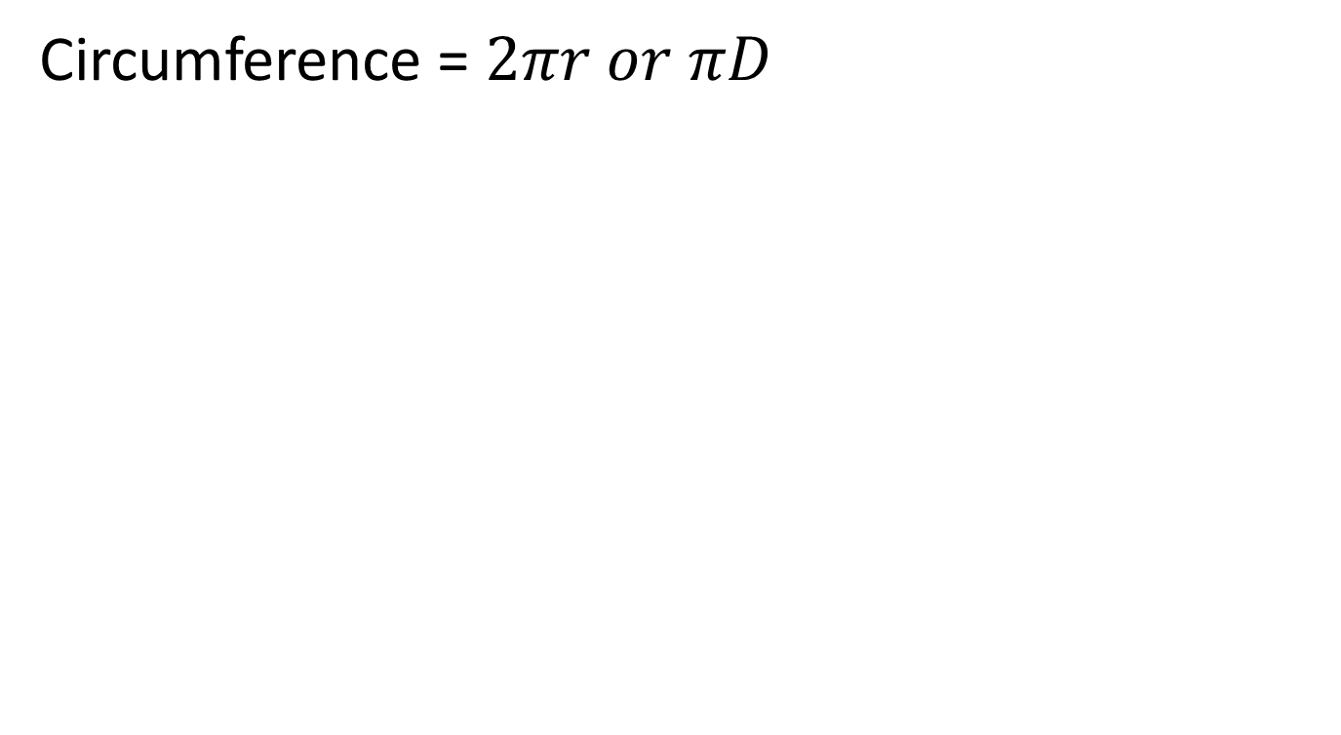
I do
Write the rule
Substitute numbers
Solve
Circumference = $2πr or πD$
5cm
6cm

Slide 5
we do
Write the rule
Substitute numbers
Solve
Circumference = $2πr or πD$
7cm
8cm

Slide 6

Finding the circumference of a circle (the perimeter)
Circumference
= π × diameter
= π × radius x 2
Draw and complete in your exercise books.
3cm
1.5cm
6cm
3.5cm
diameter
radius
diameter
radius
$$C=9.42cm$$ | $$C=9.42cm$$ | $$C=18.85cm$$ | $$C=21.99cm$$

Slide 7
Finding the area of a circle
Area
= π × radius²
4cm
Area
= π × 4²
= π × 16
= 50·2 cm² (1 d.p.)
radius

Slide 8
Finding the area of a circle
Area
= π × radius²
Draw and complete in your exercise books.
5cm
4.5cm
12cm
radius
radius
radius
$$A=78.54{cm}^{2}$$ | $$A=63.62{cm}^{2}$$ | $$A=452.39{cm}^{2}$$

Slide 9
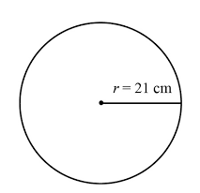
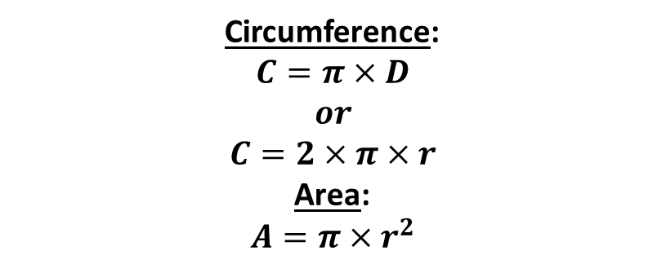
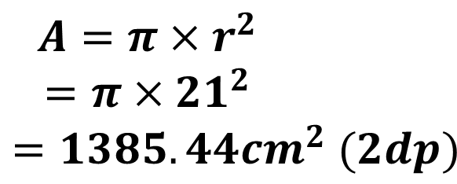
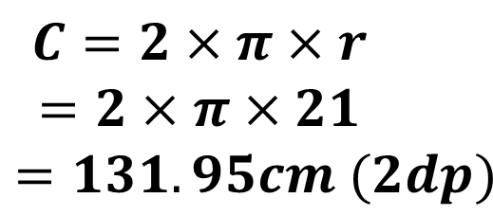
I DO
Aim: Practicing calculating area and circumference of a circle
Circumference: | Area:
$$C=2×π×r$$
$$=2×π×21$$
$$=131.95cm (2dp)$$
$$A=π×r^{2}$$
$$=π×{21}^{2}$$
$$=1385.44{cm}^{2} (2dp)$$
Circumference:
$$C=π×D$$
$$or$$
$$C=2×π×r$$
Area:
$$A=π×r^{2}$$

Slide 10
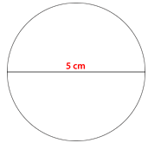
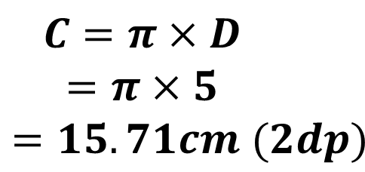
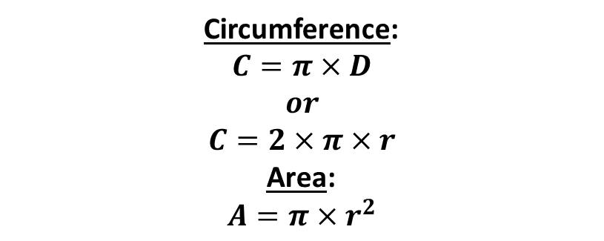
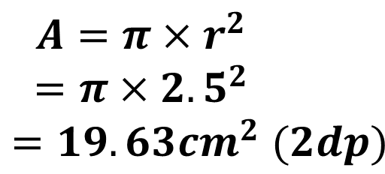
WE DO
Aim: Practicing calculating area and circumference of a circle
Circumference: | Area:
$$C=π×D$$
$$=π×5$$
$$=15.71cm (2dp)$$
$$A=π×r^{2}$$
$$=π×{2.5}^{2}$$
$$=19.63{cm}^{2} (2dp)$$
Circumference:
$$C=π×D$$
$$or$$
$$C=2×π×r$$
Area:
$$A=π×r^{2}$$

Slide 11
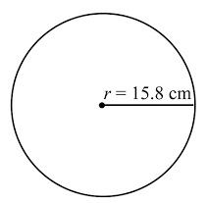

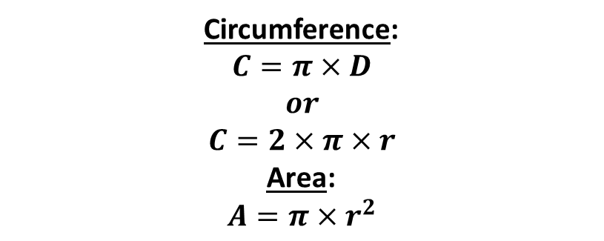
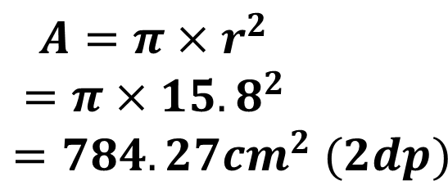
YOU DO
Aim: Practicing calculating area and circumference of a circle
Circumference: | Area:
$$C=2×π×r$$
$$=2×π×15.8$$
$$=99.27cm (2dp)$$
$$A=π×r^{2}$$
$$=π×{15.8}^{2}$$
$$=784.27{cm}^{2} (2dp)$$
Circumference:
$$C=π×D$$
$$or$$
$$C=2×π×r$$
Area:
$$A=π×r^{2}$$

Slide 12
Worksheet! Complete all circles on the worksheet by the end of class.

